Slide 1

Solar village Kettenis
Solar village Kettenis

Slide 2
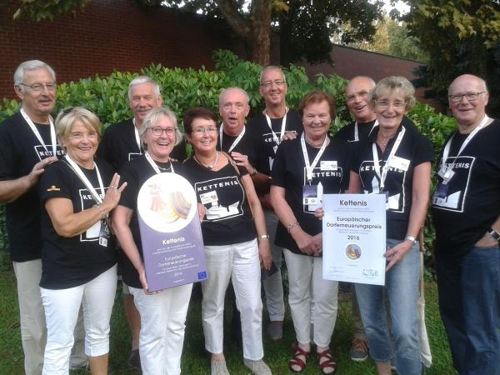
Solar village Kettenis
A project of the village group Kettenis
The aims of the village group until 2025
  village centre renewal
  Traffic claming
  Mobility for seniors
  Environment and nature protection
  Meeting place for young people
  50% renewable energies
  Extention of the school
  Charging station for electric cars

Slide 3
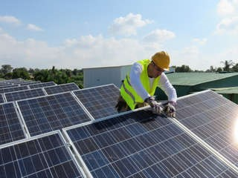
The solar village idea
Kettenis has many solar panels
27.2% of electricity demand from PV
Target= 50% by 2025

Slide 4
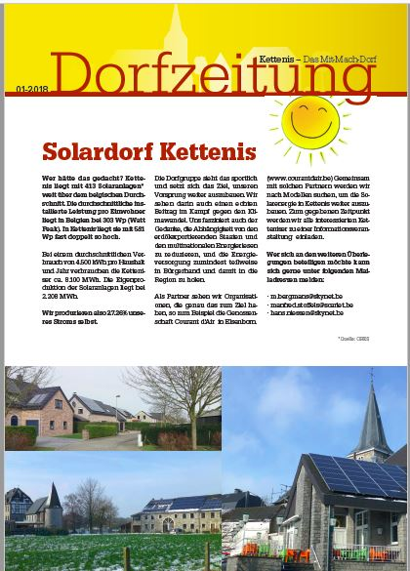
Raising public awareness 1
Report in the village newspaper

Slide 5
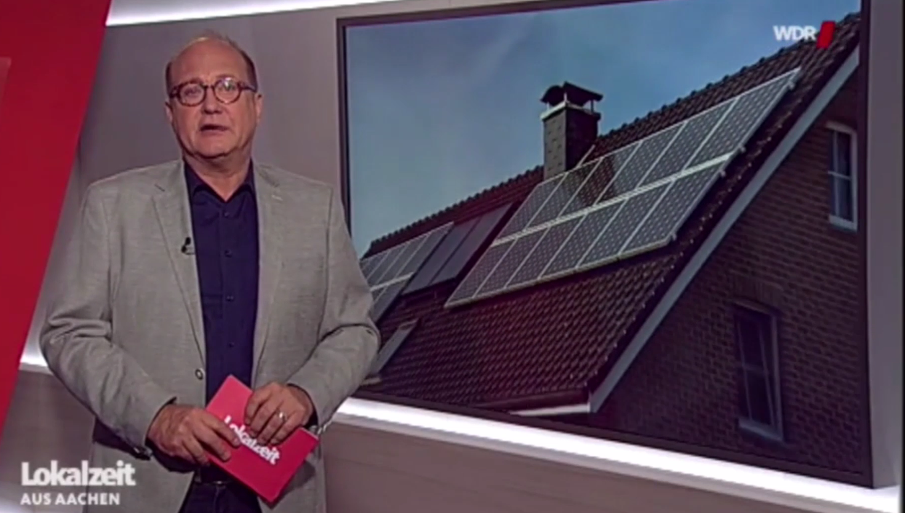
Raising public awareness 2
Report on German Television

Slide 6
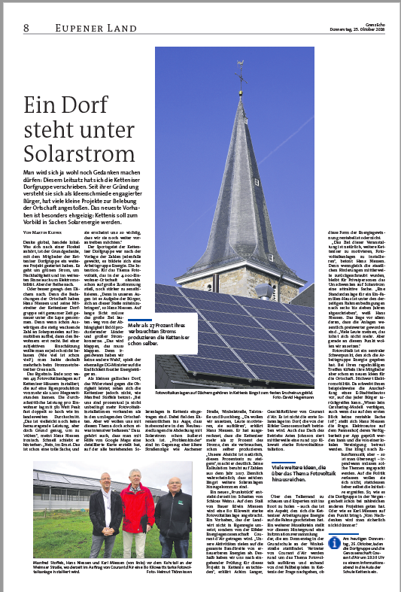
Raising public awareness 3
Report in the reagional newspaper

Slide 7
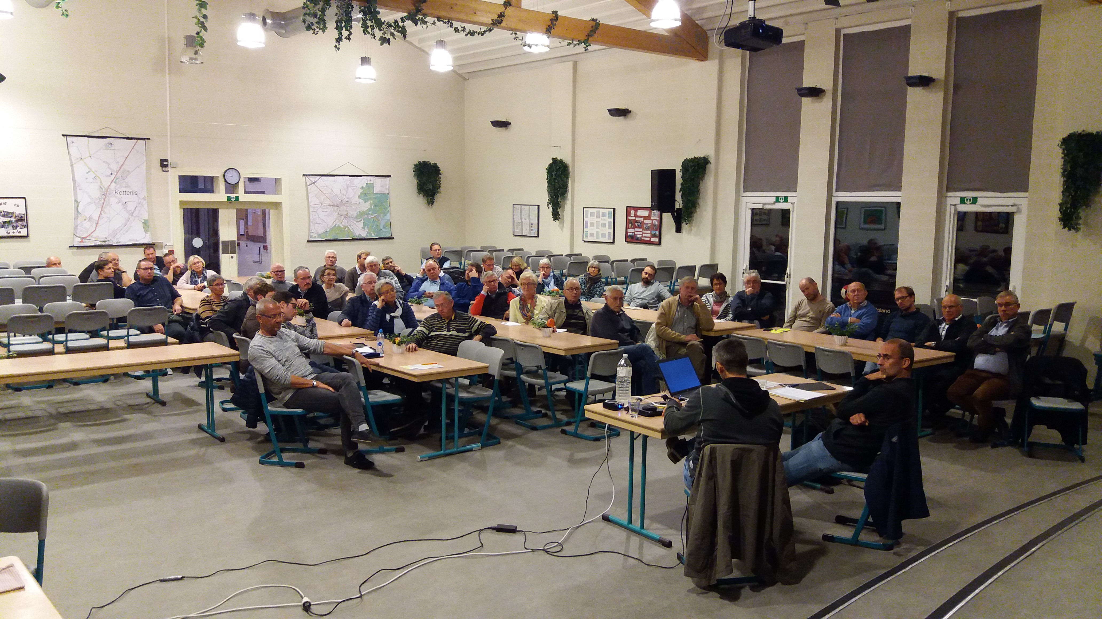
Raising public awareness 4

Slide 8
Citizens‘ meeting with the cooperative Courant d'air
Target of this meeting:
  - Demonstrate that PV is still profitable
  - Presentation of the Courant d'air citizens' cooperative
  - Presentation of models for the grouped purchase of PV
  - Advertising for renewable energies

Slide 9

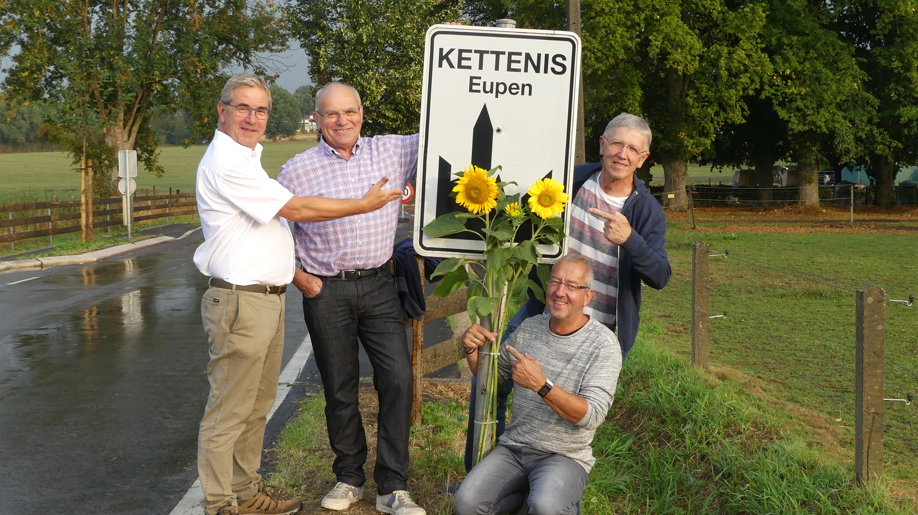
Sonnenblumenaktion
text

Slide 10
Sunflowers for the solar village
- Distribution of seeds and young plants to schoolchildren
- Distribution of seeds and young plants at the playground festival
- Planting of beds in Kettenis by the town gardener
- Involvement of beekeepers
- Appeal in the village newspaper

Slide 11
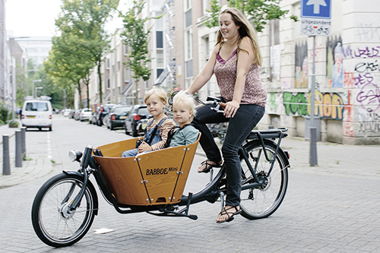
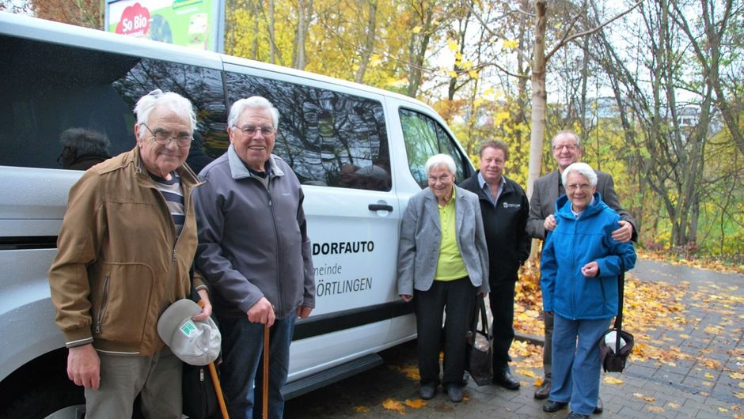
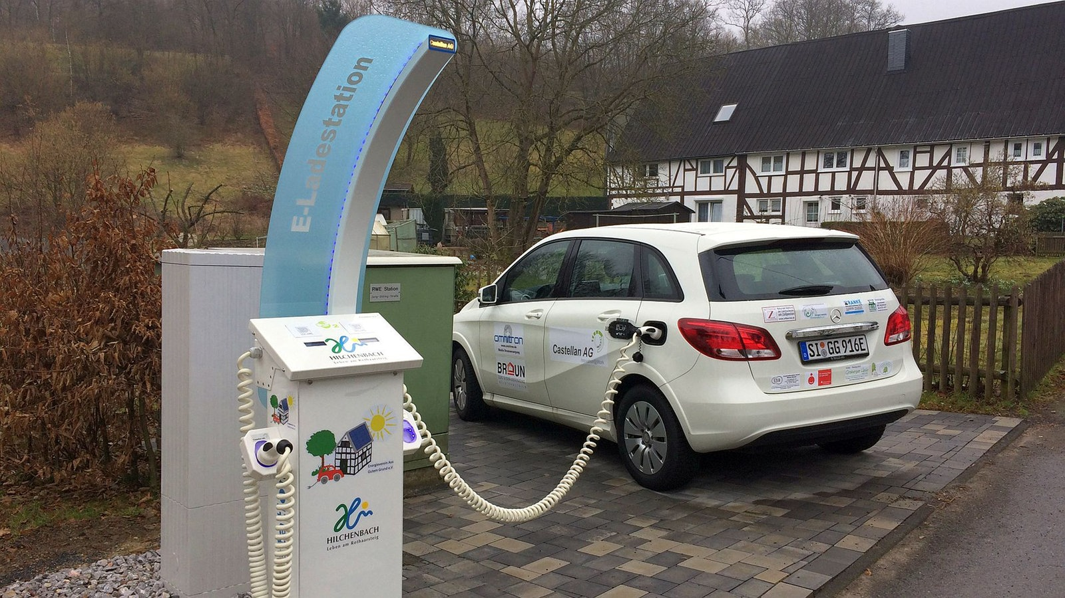
Furter plans: shared mobility
Foundation of a association for the organisation of shared mobility

Slide 12
Shared mobility
Mobility for seniors in Kettenis. Purchase of an electric car.
Foundation of an association with volunteer drivers and members who want to use the offer of being driven from A to B.
Installation of a charging station for electric cars.
Medium-term: provision of e-biles and e-cargo bikes

Slide 13
Solar village Kettenis
Thank You

